Slide 1
Udta Teer
Team 10:
Dekh mat pagli,
{ Compile } ho jayega.

Slide 2
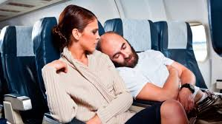
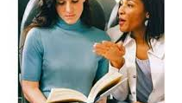
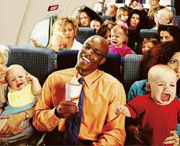
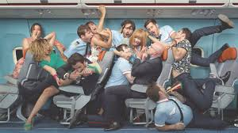

Slide 3
What do they have in common?
All represent a bad customer experience.

Slide 4
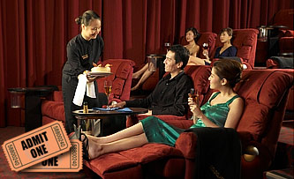
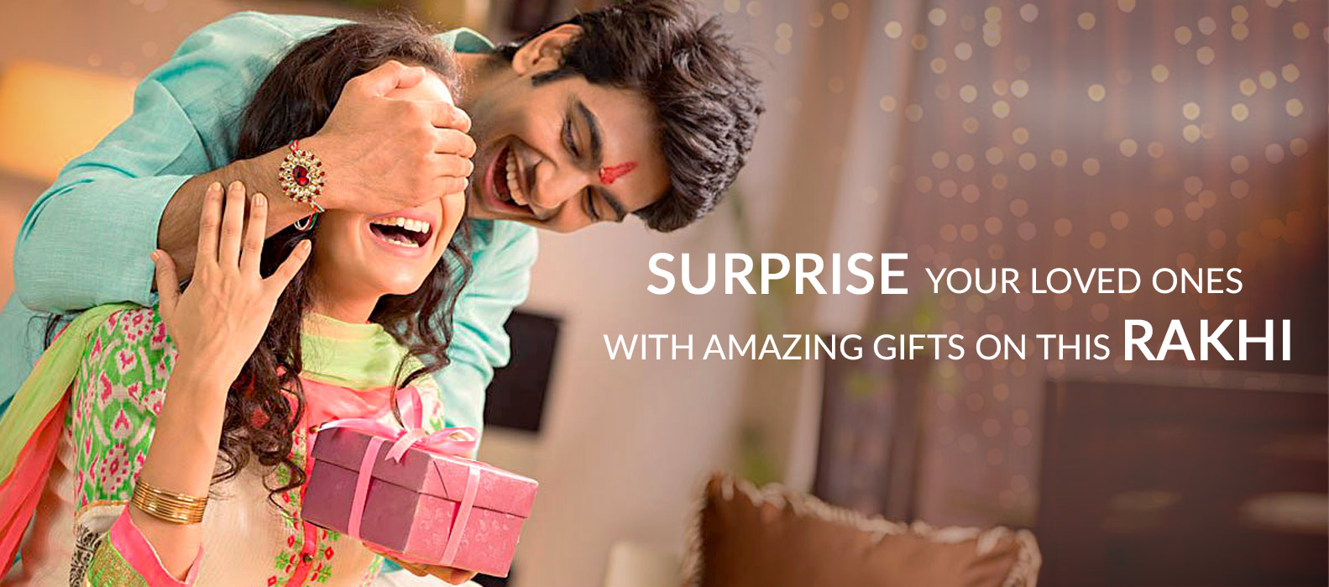
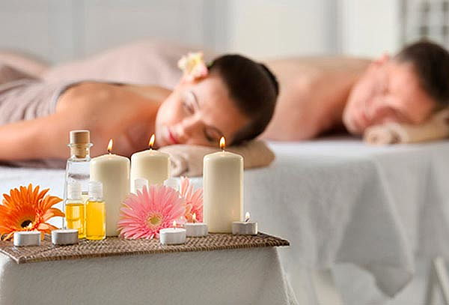


Slide 5
What do they have in common?
All represent a fantastic customer experience.

Slide 6
The world is moving towards personalized experiences, why shouldn’t the sky?

Slide 7
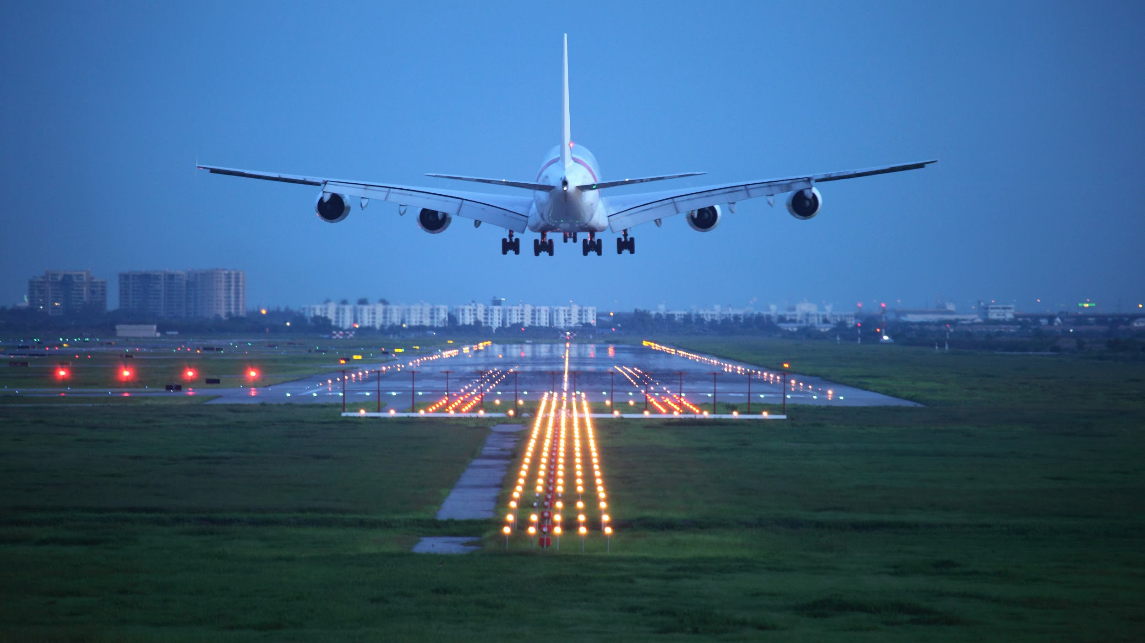
Seat Recommendation Engine.
SeReE

Slide 8
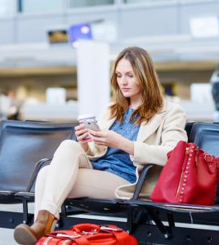
SeReE
A flight experience that understands what you need.

Slide 9
How SeReE helps you ?
Helps you understand your customer better than anyone else.
Creates customer loyalty, which facilitates Customer retention.
Better targeting for Ancillary revenues.
4 taps to a fantastic experience..

Slide 10
The SeReE magic

Slide 11







SeReE Recipe:

Slide 12

We believe amazing things can happen when like minds come together in a flight. Just like,

Slide 13
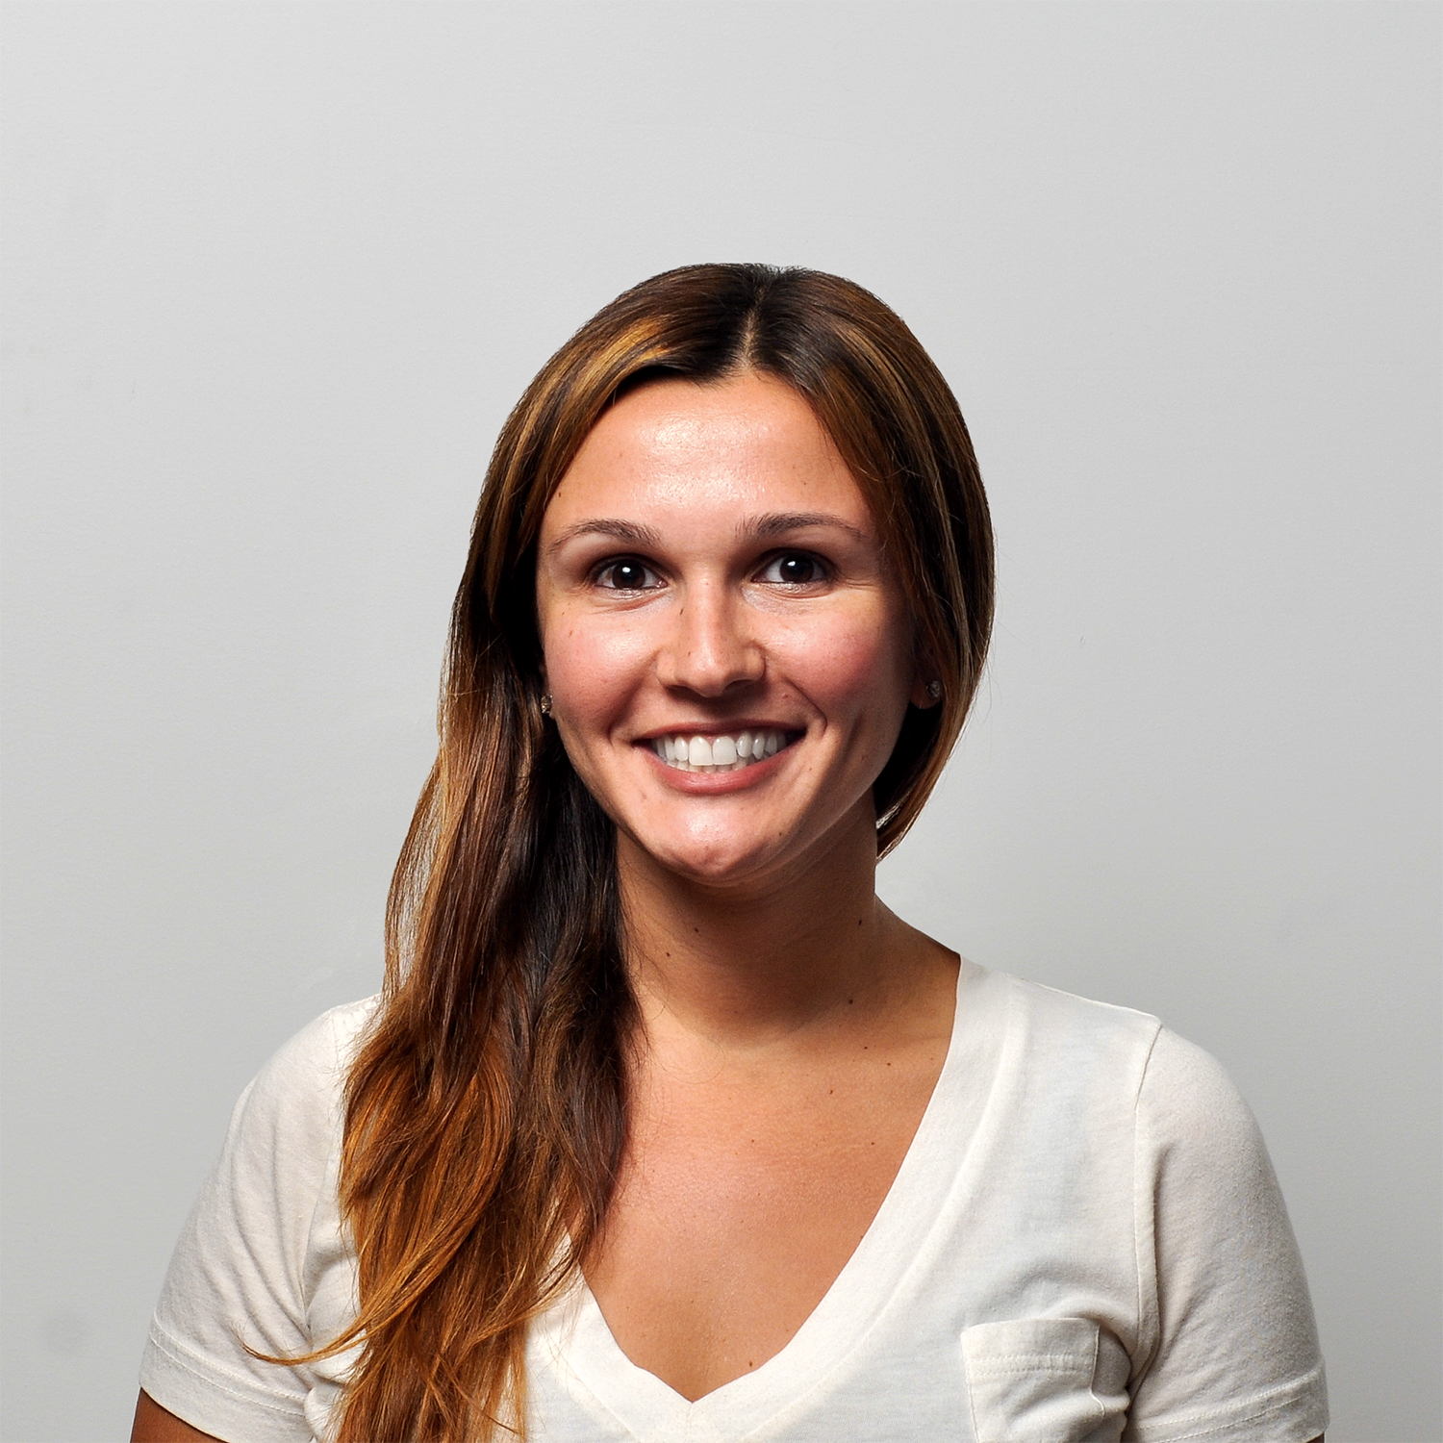
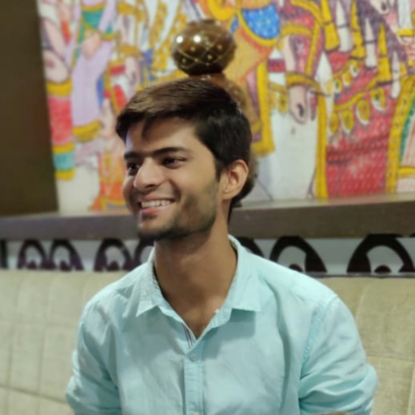
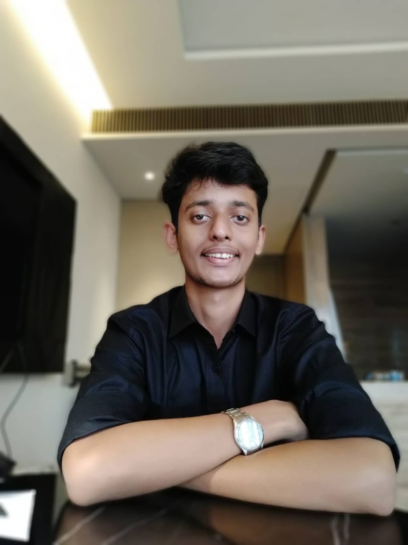
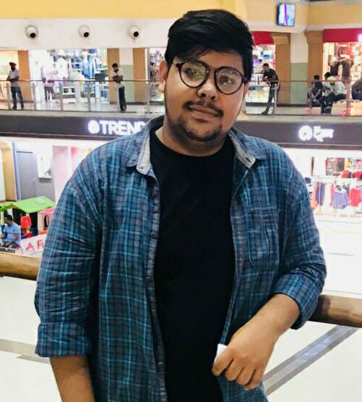
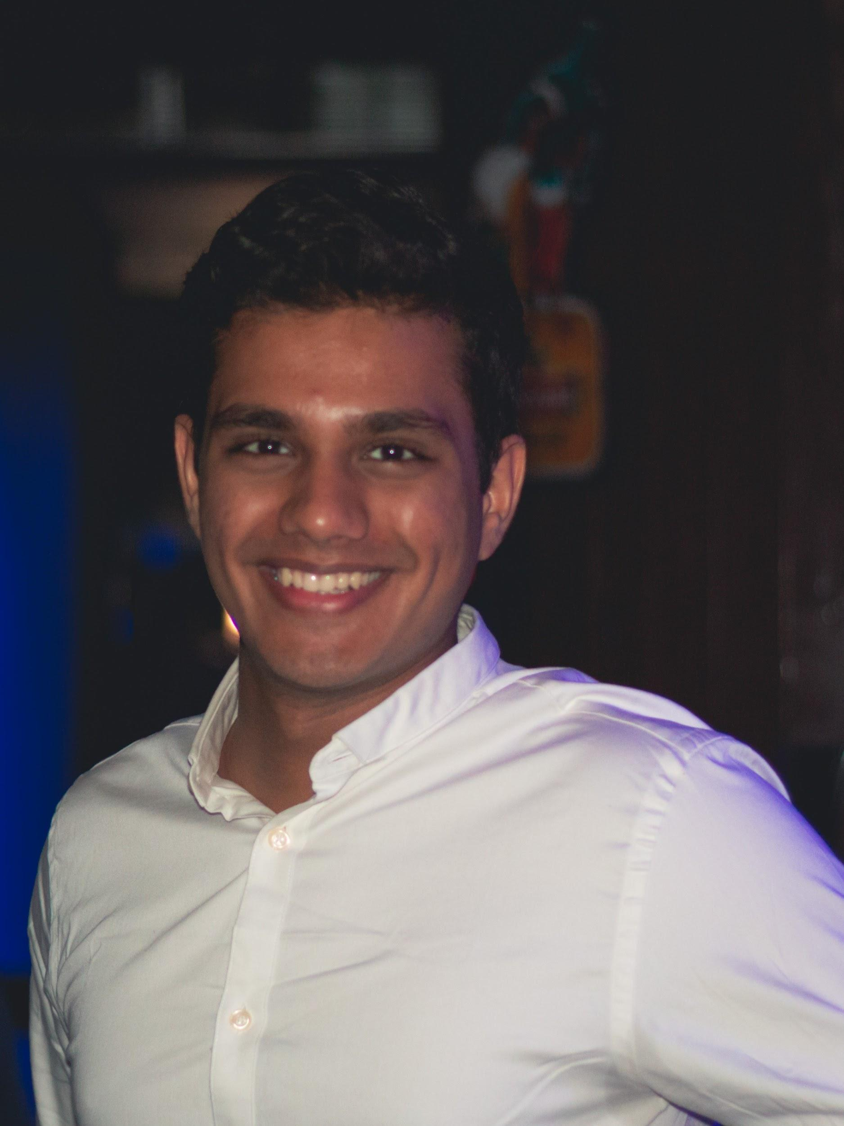
The team
Mayuri Madhur
Pulkit Chawla
Raghvendra Rao
Pulkit Arora
Karan Motiramani
Pulkit Chawla
Answer the question, “Why are we the ones to solve the problem we identified?”

